Slide 1


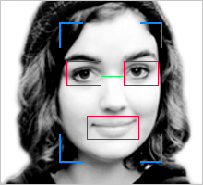

Slide 2
What’s the Problem?
16% of Facebook users tag their photos
and videos, but it takes a lot of time.
Most don’t.
Privacy concerns
Takes too much time
Notes:
Tons of photos and videos are posted on Facebook and other social media (250M photos and 200K videos daily uploaded on FB; 72hours of video uploaded on YouTube every minute)

Slide 3
Our Solution
A facial recognition app that identifies your Facebook friends in your videos
Save power taggers a lot of time
Puts the onus on the user to approve before posting

Slide 4

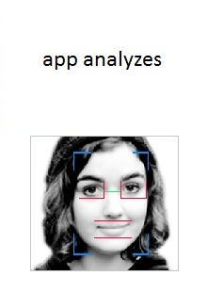

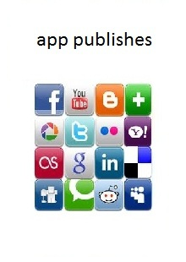
How It Will Work

Slide 5
Technology & UI Mocks

Slide 6

Input Video

Slide 7


Frame Capture → Analysis → Output

Slide 8

Frame Capture → Analysis → Output

Slide 9
Frame Capture → Analysis → Output
Identified: Justin

Slide 10

Multiple Face Recognition
Identified: Brian, Varad, Justin

Slide 11


Slide 12


Slide 13


Slide 14
Facial Recognition Industry and Competition
Wide open, big potential;
Lots of Acquisitions (Facebook acquired face.com, Apple – Polar Rose)
Huge privacy and legal issues:
“…As of today, no laws or regulations specifically prevent your face from being detected or recognized without your consent.” Daniel Solove, George Washington University Law School
Potential future of video tag naming in social media (B2C), as well as security, shopping and entertainment industries (B2B).
No direct competitors in AppStore and Facebook app directory

Slide 15
Tagging Behavior on Facebook*
based on 40 on-campus interviews and on-line survey of 250 people

Slide 16
Business Model
Free for the first 10 uploads (B2C market)
Further research on B2B market
63M people - FB and YouTube users using iOS and Android in U.S.
15M (24%) will download
for free
5M will purchase at $1.99 (30%)
$10M TAM

Slide 17
Web Site http://unbouncepages.com/tagyourit Team Brian Elena Justin Varad Vim

